Slide 1

LOG ANALYZE

Slide 2
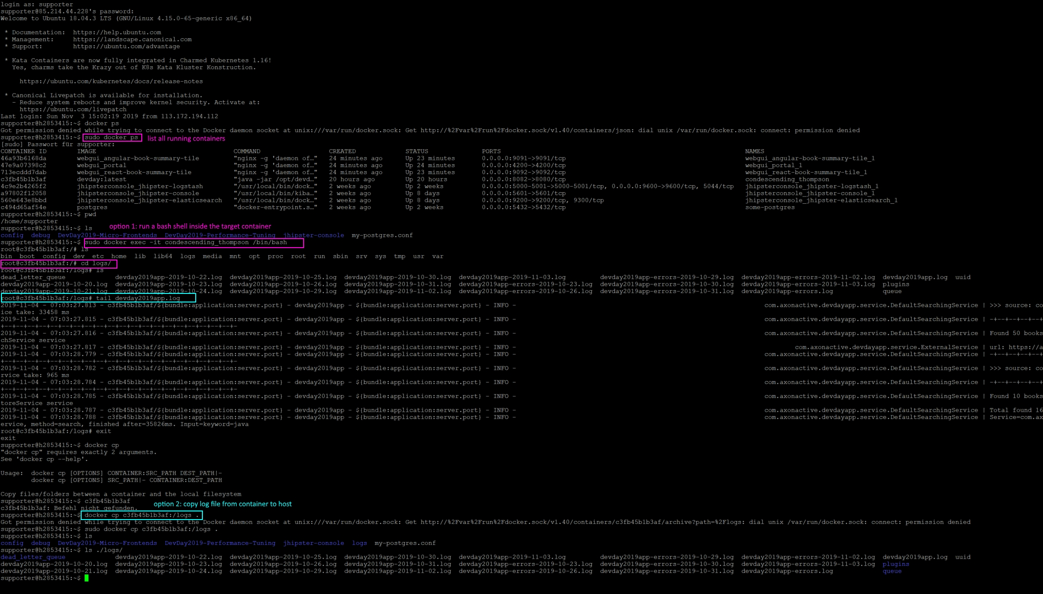
lots of step when reading log !!!
Notes:
Taking lots of step to read log?
Hard to find out events at a specific time?
Delete log file by accident?

Slide 3
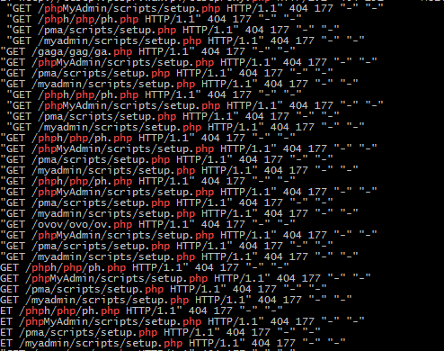

where is my log?

Slide 4
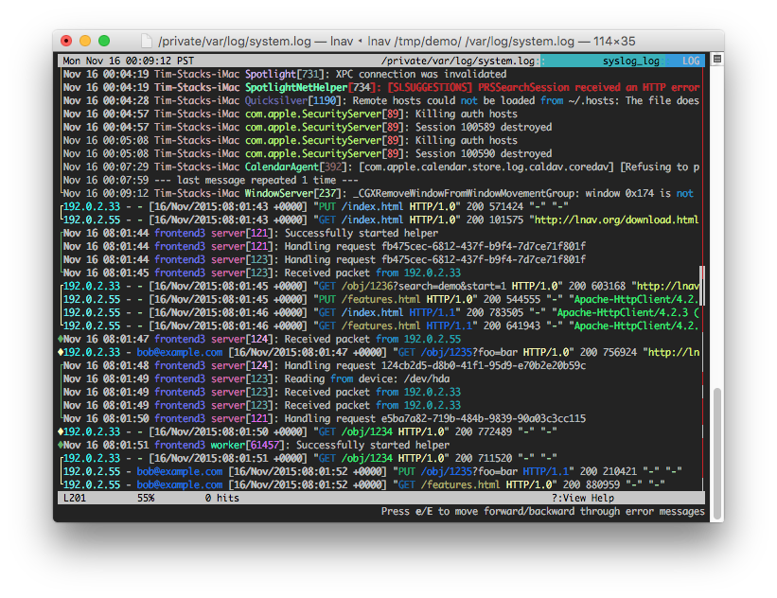

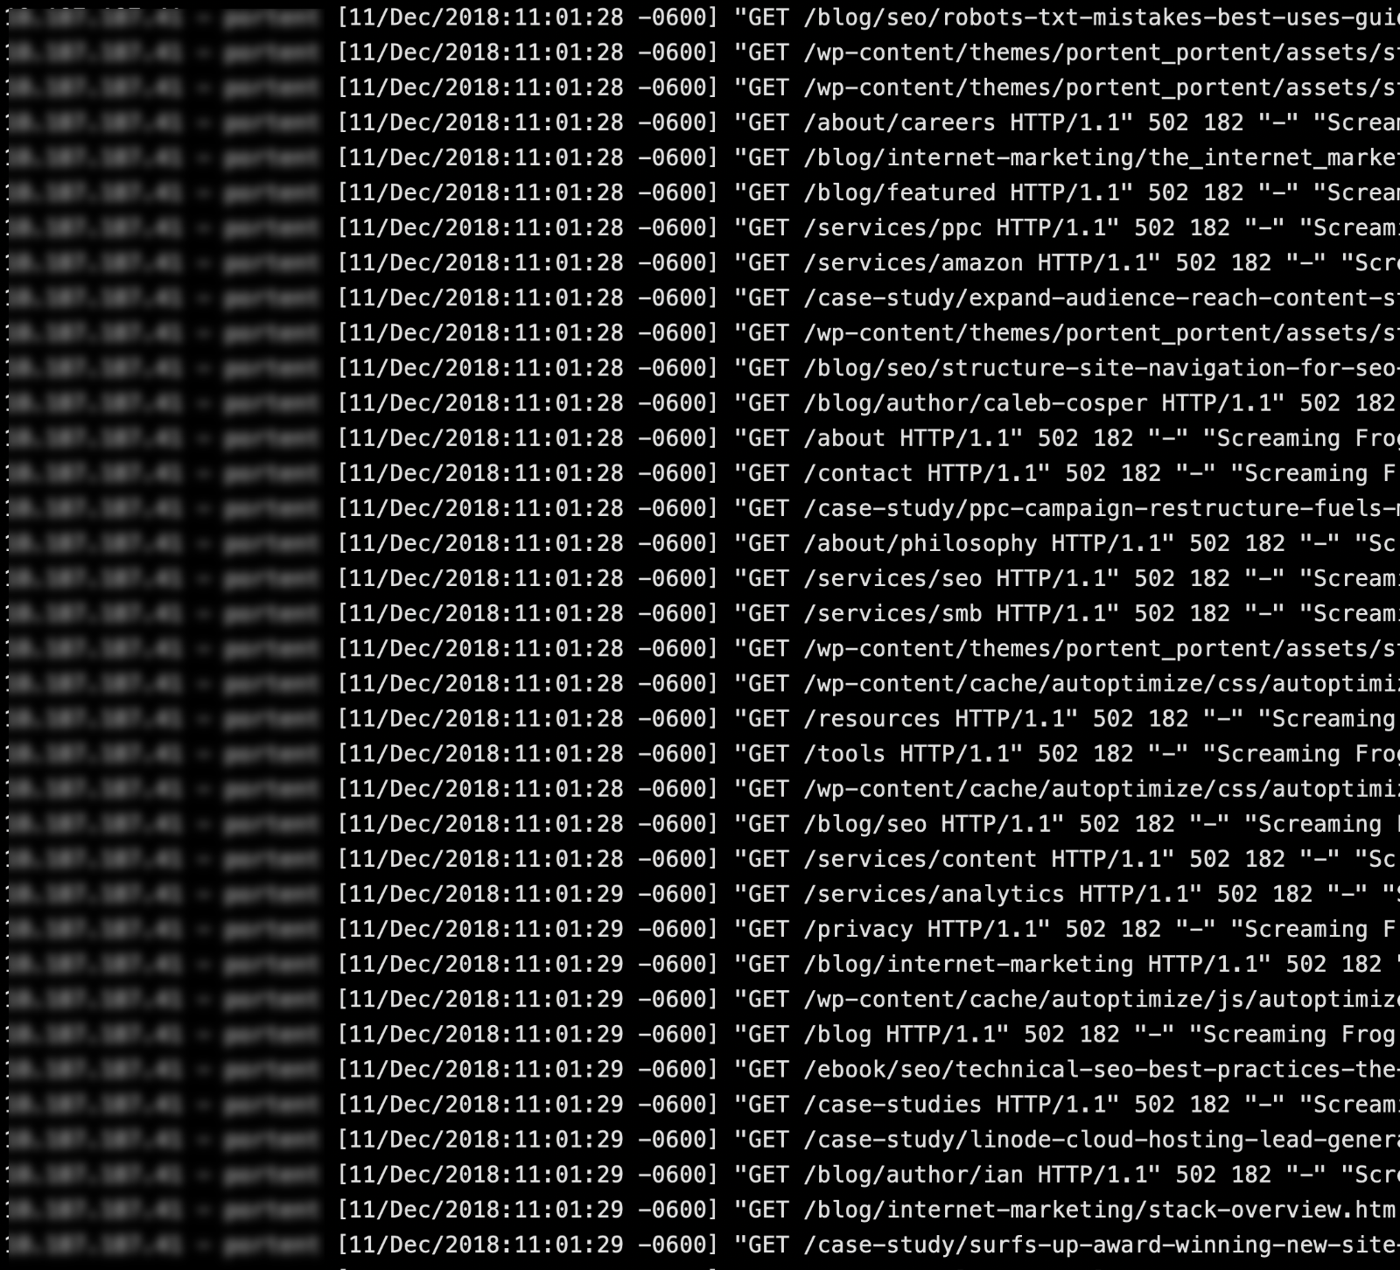

Slide 5

server response time?
product's customer usage?
most called service?
resource usage?
Notes:
Want to know your product:
Resource usage?
Response time?
Most called service?
....
How customers use our product?

Slide 6
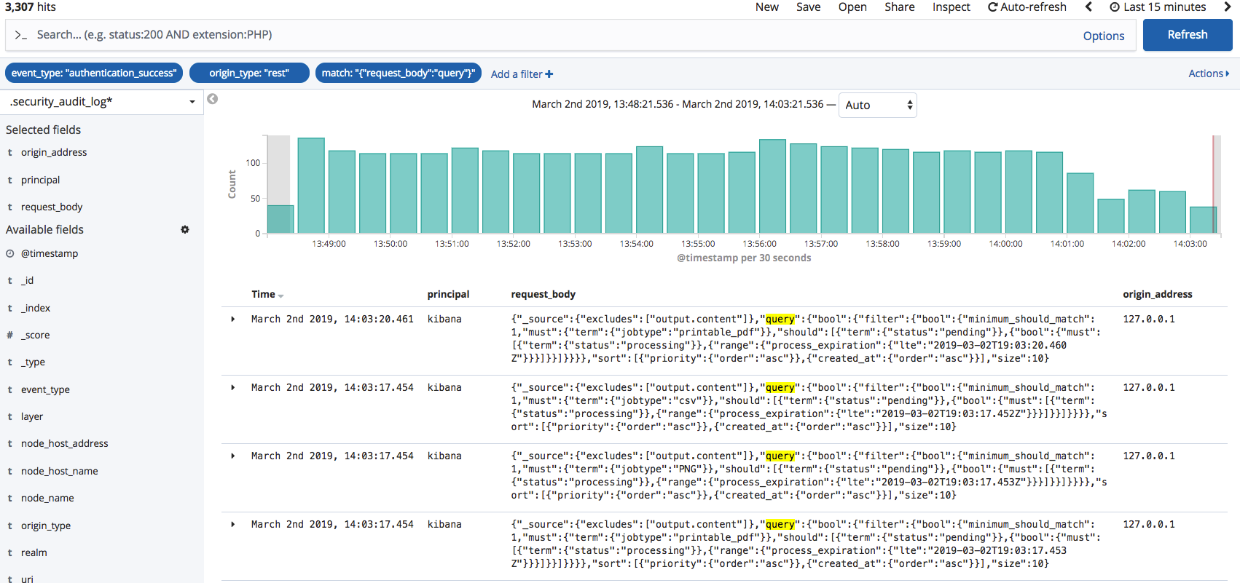
How about?

Slide 7
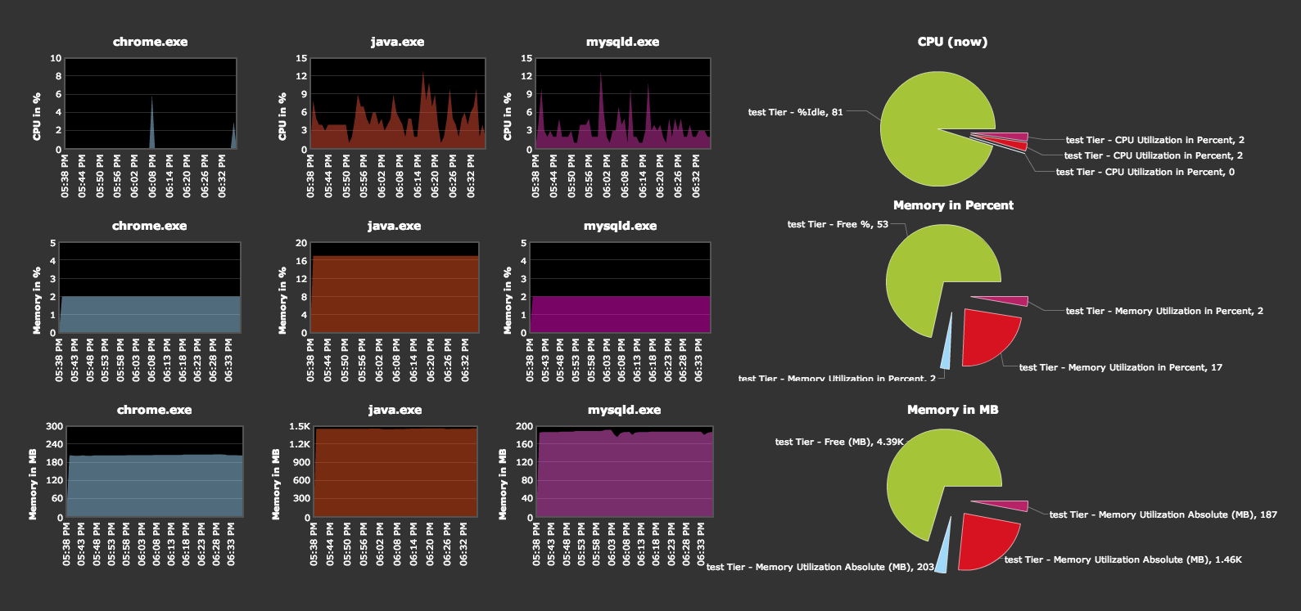
Benefits
Production monitoring and debugging
Resource usage

Slide 8
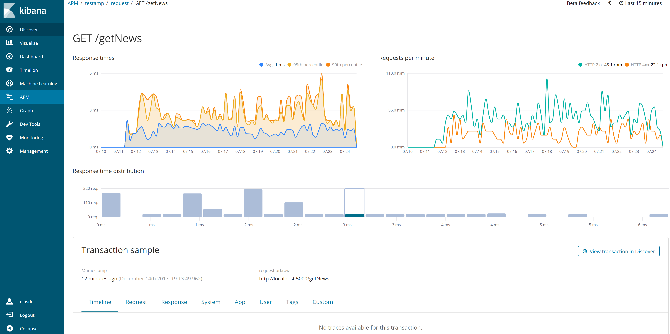
Benefits
Performance analysis

Slide 9
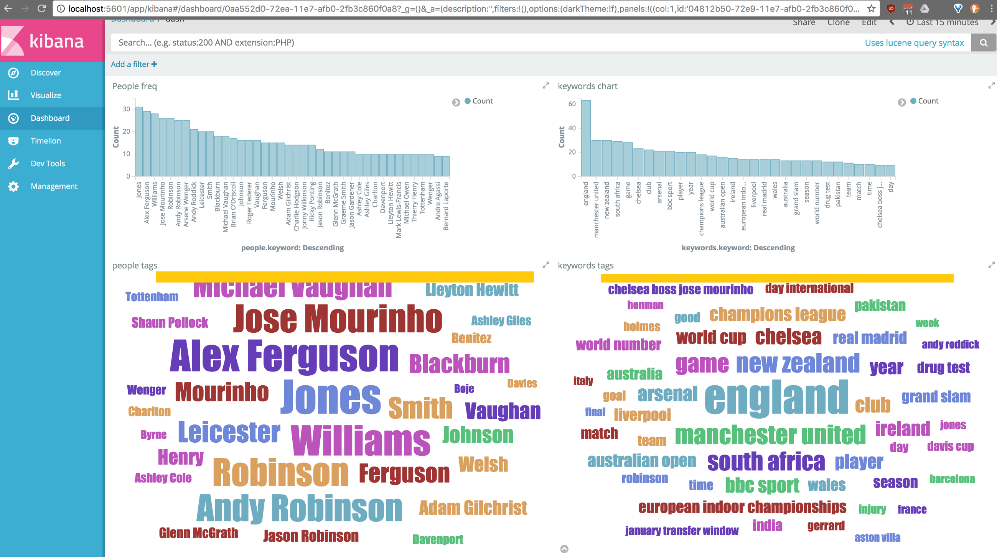
Benefits
Tracking client requests
Identifying key trends

Slide 10
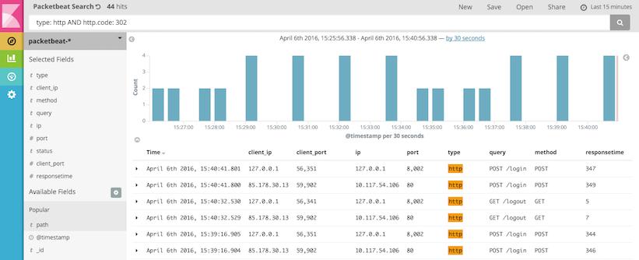
Benefits
Easy to read even if you're not developer
Easily and quickly to find information

Slide 11

Benefits
Live logging
Understand our system and the way user interact with it.

Slide 12
Work-flow

Slide 13

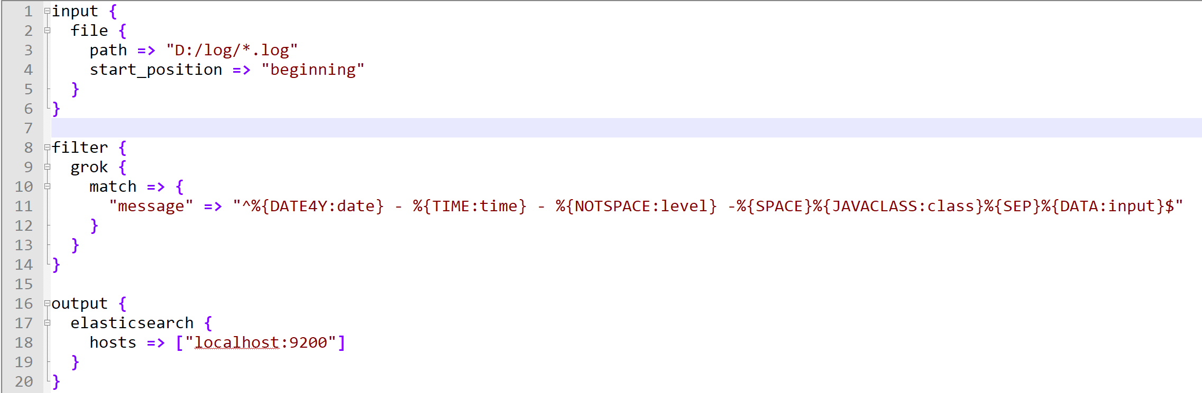
Logstash
Parse log line into readable format

Slide 14
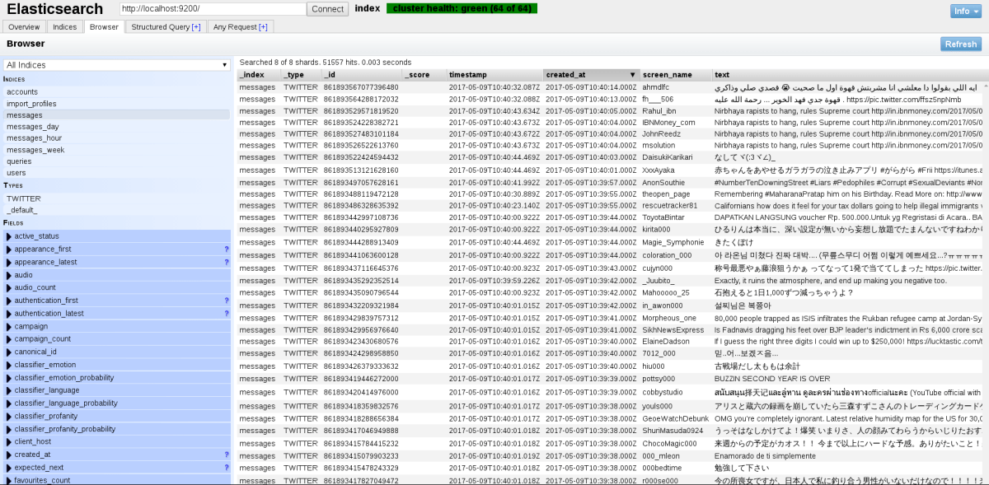
Elasticsearch
Store logs
Act as a data source for Kibana

Slide 15
Kibana
Display data using chart

Slide 16
Getting started
1. Know your log structure
2. Parse log by Logstash
3. Visualize by Kibana

